Slide 1



emBO++ 2019
embedded C++
for
embedded C programmers
Wouter van Ooijen MSc (ir)
Hogeschool Utrecht, Netherlands,
senior lecturer Computer Engineering
SG14 member
wouter.vanooijen@hu.nl
Notes:
Wouter van Ooijen, if too difficult Woooter will do
Backgroundf Computer Science, passion electronics and hardware/software borderland
Polytechnics
Technical Informatics, small specialization~30-50 std annually
I am NOT working in industry, I guide the next generations into inductry. I hope well prepared

Slide 2

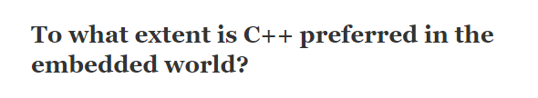

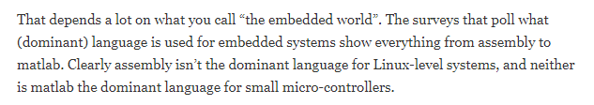
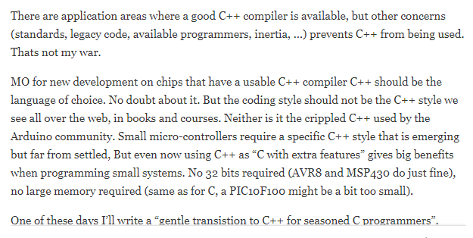

Slide 3
Agenda
Define ‘embedded’
From C to C++
Hwlib: my C++ embedded OO library

Slide 4
embedded

Slide 5


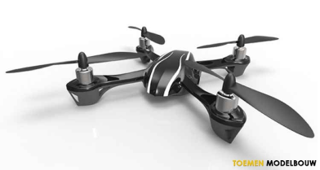
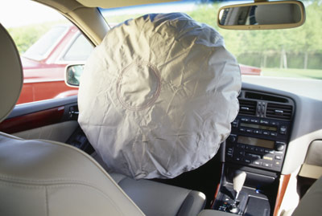

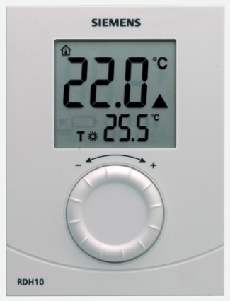
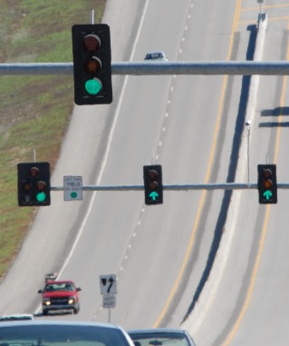
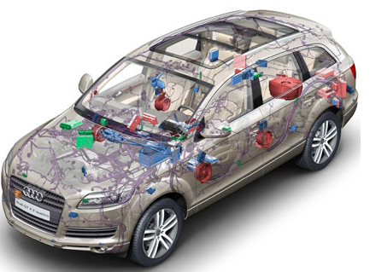
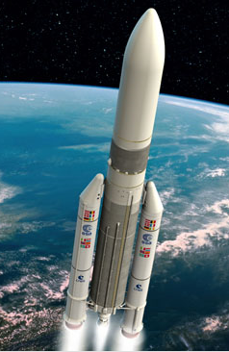

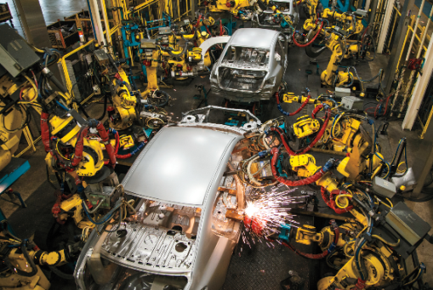
Wide span of seriousness
fun
deadly serious
Notes:
Furby to nuclear power plant

Slide 6
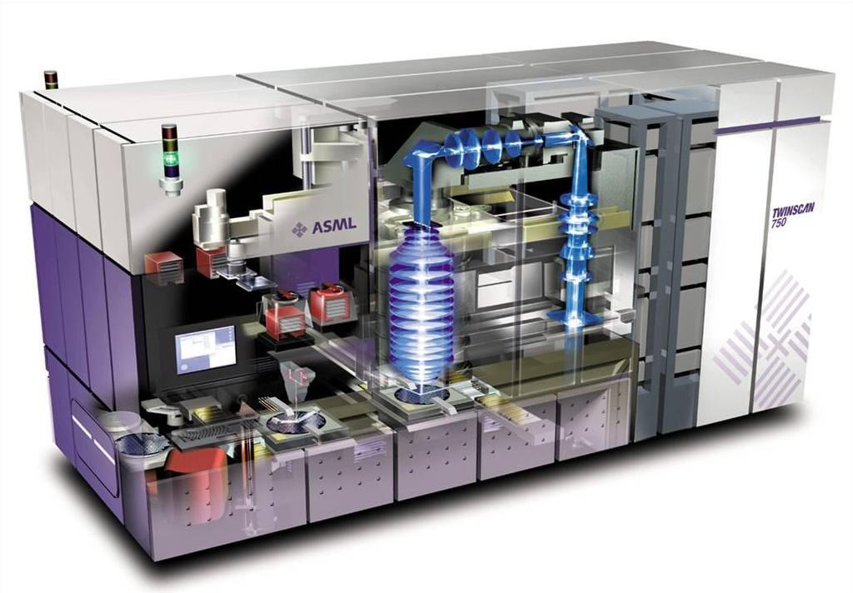
Wide span of response time
µs
ms
s
Notes:
Nuclear doesn’t require that qiock responses

Slide 7
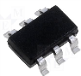
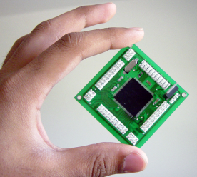
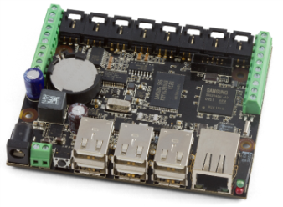
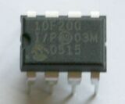
Wide span of hardware
1KiB
1MiB
1GiB
4-bit
64-bit
8-bit : 8051, PIC, AVR, …
No full standard C/C++
16-bit : MSP430, PIC, …
32-bit : ARM, MIPS, Tensilca, Intel, …

Slide 8

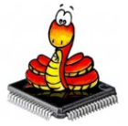


Wide span of support software
1KiB
1MiB
1GiB
Bare metal:
libraries
no separate OS
Desktop OS:
Linux
Windows
Interpreter
RTOS

Slide 9
fast trading
gaming
MiB, GiB
GHz, multi-core
Memory latency, caches
simulation
large-embedded
bytes, KiB
MHz, Interrupts
Hardware peripherals
Battery life-time
small-embedded

Slide 10
‘my’ embedded
1KiB
1MiB
1GiB
Bare metal, no (separate) OS
Kb RAM and ROM (not Mb)

Slide 11
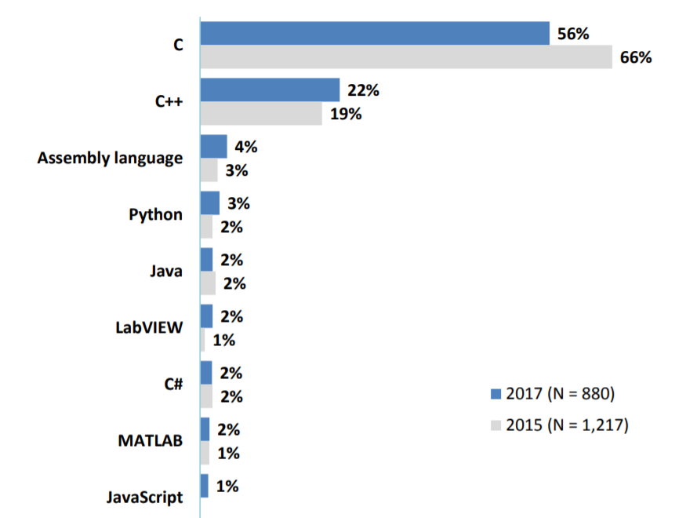
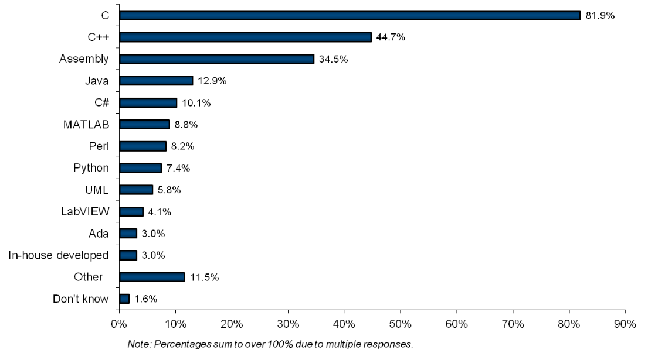
Embedded languages
Probably not my type of embedded

Slide 12
C ➔ C++

Slide 13
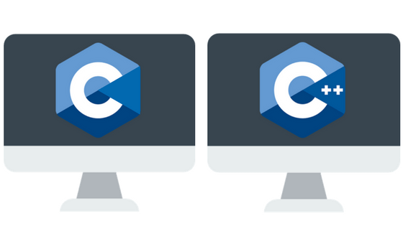
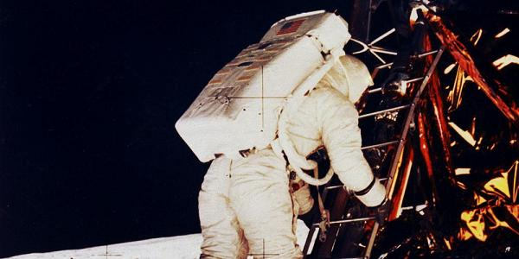

Slide 14



Face the opposition: reasons to stick to C
Some good ones
Some debatable ones
Some bad ones

Slide 15
Stick to C : some good reasons
No (good, mandated, … ) C++ compiler available
C is required (by the customer, law, insurance, … )
Your code relies on Variable Length Arrays

Slide 16
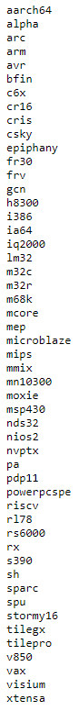
GCC targets
No (good, mandated, … ) C++ compiler available
C is required (by the customer, law, insurance, … )
Your code relies on Variable Length Arrays
Missing?
PIC
8051
AVR library support is minimal

Slide 17

No (good, mandated, … ) C++ compiler available
C is required (by the customer, law, insurance, … )
Your code relies on Variable Length Arrays
C

Slide 18
Variable Length Array
No (good, mandated, … ) C++ compiler available
C is required (by the customer, law, insurance, … )
Your code relies on Variable Length Arrays
void f( int n ){
int array[n];
. . .
}
Mandatory in C99, optional in later versions
Not in standard C++
Available in GCC as an extension

Slide 19
Why use C : some temporary reasons
large existing C code base
no C++ programmers available
no guidelines, books, courses, etc. for C++

Slide 20

Don’t throw your C away!
large existing C code base
no C++ programmers available
no guidelines, books, courses, etc. for C++
start with the lowest ambition: compile your C as C++

Slide 21
No C++ programmers available
large existing C code base
no C++ programmers available
no guidelines, books, courses, etc. for C++
ask your programmers, you might be surprised
get some (good luck…)
get training
begin with the small steps

Slide 22
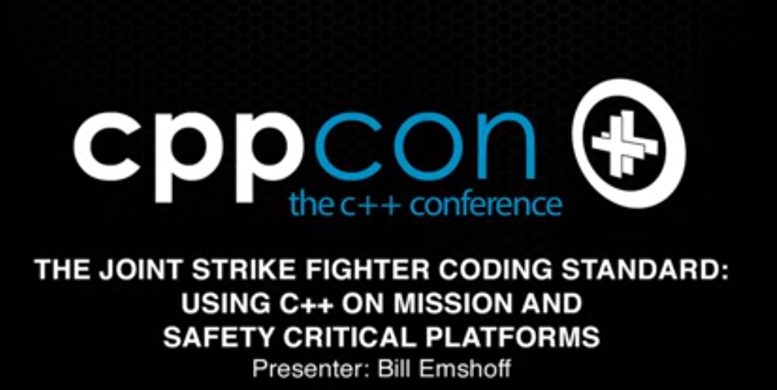
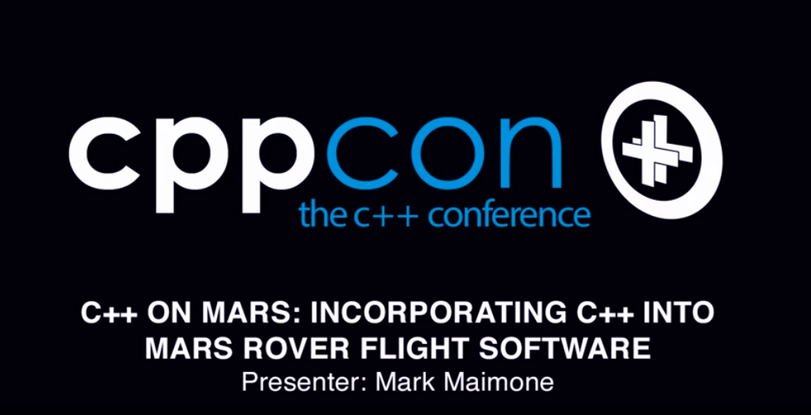
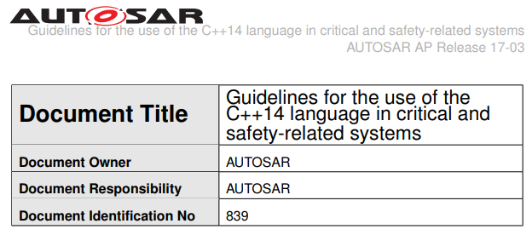
No guidelines, books, courses, …
large existing C code base
no C++ programmers available
no guidelines, books, courses, etc. for C++
again, start with the small steps
there is some material & experience
communicate!

Slide 23
Why use C : some debatable reasons
C++ is larger, hence code is less easy to read
C++ makes code execution less predictable (debug)

Slide 24
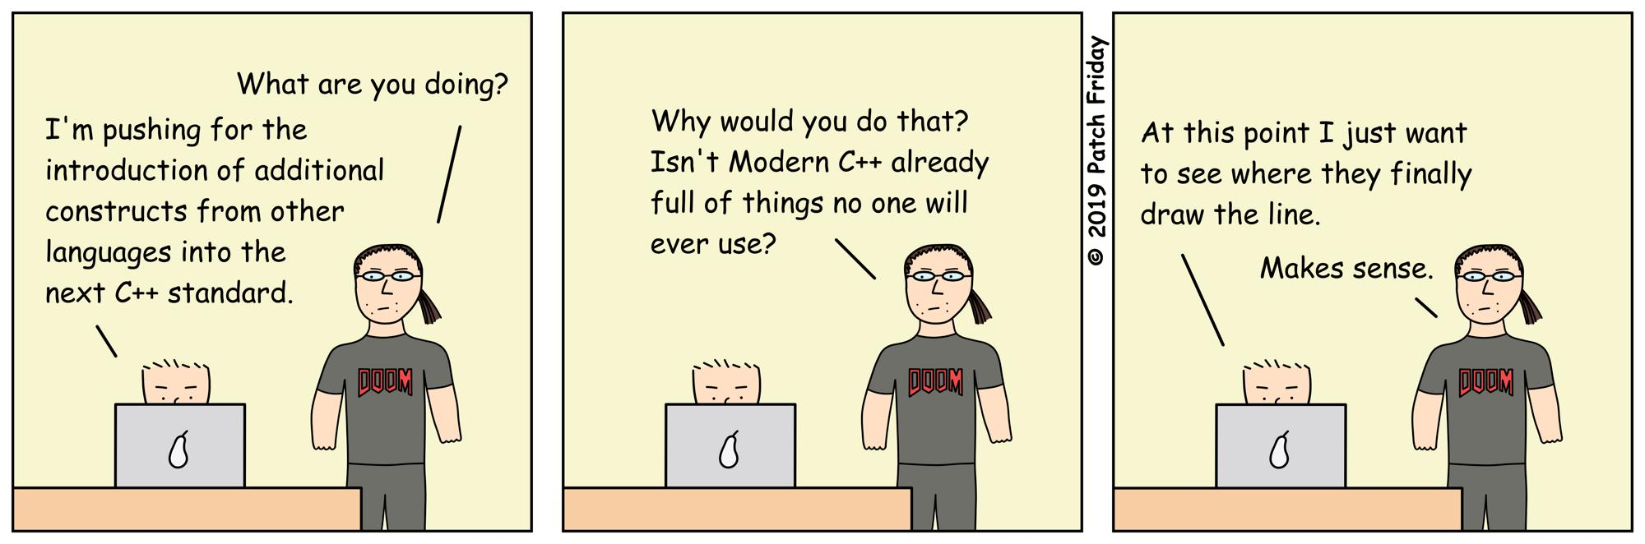
Yes, C++ is large
C++ is larger, hence code is less easy to read
C++ makes code execution less predictable (debug)

Slide 25
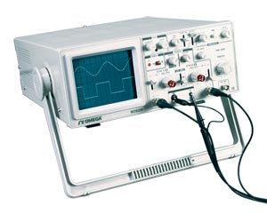
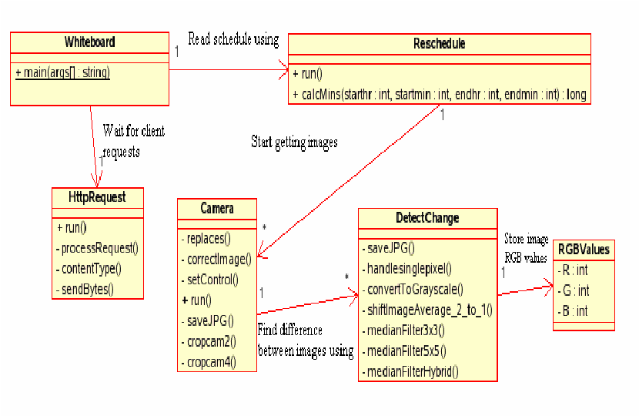
Development styles
C++ is larger, hence code is less easy to read
C++ makes code execution less predictable (debug)
EE / C – style
See what you do – down to assembly
Write quickly, you’ll need the time later on for debugging
The effect is what you observe (UB is just another compiler feature)
If it works, don’t touch it
Big vendor selling points: debuggers, generators
CS / C++ - style
Build and use abstractions that you trust
Write carefully, review, test
The effect is what it should be (no UB allowed)
If the source is not right, correct it (and re-test)
I don’t even have a debugger for any of the chips I use…

Slide 26
Why use C : some bad reasons
C++ is slower
C++ produces larger executables
➔ Use your toolchain appropriately

Slide 27

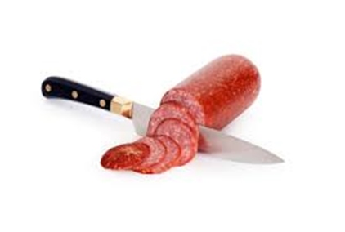
Strategies

Slide 28
Cold Turkey : start a new project in C++
Get the right people (might be tricky):
Don’t rely on C-style EE’s
Don’t rely on C++-desktop style CS’s.
Fresh students, hobbyists, outside help, …
➔ Don’t feel obliged to use the full language!

Slide 29

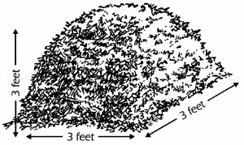

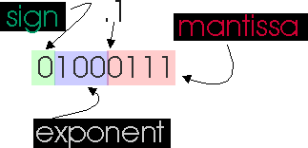
C++ features to avoid
(probably) avoid:
RTTI
the heap (free store), hence
exceptions
standard containers (except std::array<>)
floating point

Slide 30
Salami technique : small steps first (world domination has to wait)
Low-impact (don’t disturb the C-culture too much)
Medium-impact (expect some resistance..)
OO (familiar to non-embedded C++ programmers)
Modern (keep an expert nearby)

Slide 31

Low-impact C++ features
const correctness
binary literals
’ separator in literals
namespaces
enum class
by-reference parameters
constexpr
if constexpr

Slide 32
const correctness
const correctness
binary literals
’ separator in literals
namespaces
enum class
by-reference parameters
constexpr
if constexpr
A const is read-only.
In C, ”abcd” is a (non-const) char pointer
void clear( char * s ){
s[ 0 ] = ’\0’;
}
clear( ”Hello world” );

Slide 33
Binary literals
const correctness
binary literals
’ separator in literals
namespaces
enum class
by-reference parameters
constexpr
if constexpr
The first purpose of code is to be readable.
The base you choose conveys information about the value.
Some values are simply bits.
0b1011 // a bit mask
083 // not written by me
0x0B // a value, but not for a calculation
11 // the quantity 11

Slide 34
’ separators in literals
const correctness
binary literals
’ separator in literals
namespaces
enum class
by-reference parameters
constexpr
if constexpr
I can’t quickly read numbers with a large number of digits.
Can you?
wait_ns ( 1000000000 ); // one second (if I got the 0’s right)
wait_ns ( 1000 * 1000 * 1000 ); // don’t worry, it’s a ct-expression
wait_ns ( 1’000’000’000 );

Slide 35
namespaces
const correctness
binary literals
’ separator in literals
namespaces
enum class
by-reference parameters
constexpr
if constexpr
// C style
mygreatlibrary_importantfunction{ ... }
// C++ style
namespace mygreatlibrary {
void importantfunction(){ . . . }
};

Slide 36
namespaces
const correctness
binary literals
’ separator in literals
namespaces
enum class
by-reference parameters
constexpr
if constexpr
// C style
mygreatlibrary_importantfunction();
// C++ style
mygreatlibrary::importantfunction();
// or
using namespace mygreatlibrary;
importantfunction();

Slide 37
Enum class
const correctness
binary literals
’ separator in literals
namespaces
enum class
by-reference parameters
constexpr
if constexpr
// C style / old C++ style
enum color { color_black, color_white, color_red, ... };
enum player { player_white, player_black };
void paint( color c );
paint( player_white );
// new C++ style
enum color { black, white, red, ... };
enum player { white, black };
void paint( color c );
paint( white ); // compiler error
paint( player::white ); // compiler error
paint( color::white );

Slide 38
By-reference parameters
const correctness
binary literals
’ separator in literals
namespaces
enum class
by-reference parameters
constexpr
if constexpr
// C style
void inc( int * p ){
*p++; // did I get that right?
}
int n;
inc( &n );
// C++ style
void inc( int & p ){
p++;
}
int n;
inc( n ); // some C folks find this annoying

Slide 39
constexpr
const correctness
binary literals
’ separator in literals
namespaces
enum class
by-reference parameters
constexpr
if constexpr
Most micro-controllers have 4-16 times more FLASH than RAM.
A value in FLASH can’t accidentally be overwritten.
Calculating (even at start-up) takes time (and FLASH).
I am no good at excel and cut-n-paste.
➔ I want as much in FLASH as possible!

Slide 40
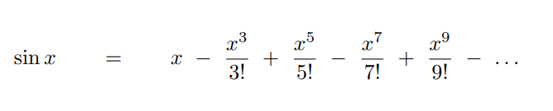
constexpr
const correctness
binary literals
’ separator in literals
namespaces
enum class
by-reference parameters
constexpr
if constexpr
constexpr double pow( double v, int n ){
return ( n == 0 )
? 1
: v * pow( v, n - 1 );
}
constexpr int fac( int n ){
return ( n == 0 )
? 1
: n * fac( n - 1 );
}
constexpr double sine( double angle ){
double value = 0;
for( int i = 1; i < 10; i += 2 ){
value += (( i % 4 ) == 1 ? 1 : -1 ) * pow( angle, i ) / fac( i );
}
return value;
}

Slide 41
constexpr
const correctness
binary literals
’ separator in literals
namespaces
enum class
by-reference parameters
constexpr
if constexpr
constexpr double pi = 3.14;
constexpr int height = static_cast< int >( 1000 * sine( 2 * pi / 12 ));
int main( void ){
// wait for the terminal emulator to start up
hwlib::wait_ms( 1'000 );
hwlib::cout << "1000 * sin( 30 ) = " << height << "\n";
}
no run-time calculation
no floating-point code linked in!

Slide 42
Medium-impact C++ features
Overloading
Default parameters
Transparent Data Types
Abstract Data Types (private)

Slide 43
Overloading
Overloading
Default parameters
Transparent Data Types
Abstract Data Types (private)
// C style
print_int( 42 );
print_double( 3.14 );
print_string( ”Hello” );
// C++ style
print( 42 );
print( 3.14 );
print( ”Hello” );
Seems to be a very personal thing

Slide 44
Default parameters
Overloading
Default parameters
Transparent Data Types
Abstract Data Types (private)
// C style
print( 42 ); // 42
print_in_field( 42, -1 ); // 42
print_in_field( 42, 5 ); // ===42
// C++ style
print( int x, int p = -1 );
print( 42 ); // 42
print( 42, 5 ); // ===42
Also seems to be a very personal thing

Slide 45
Transparent data types
Overloading
Default parameters
Transparent Data Types
Abstract Data Types (private)
write( int x, int y, bool v );
write( x, y, 1 );
write( x + 1, y + 1, 0 );
struct xy { int x, int y, ... };
write( loc );
write( loc + xy( 1, 1 ), 0 );
I hate adjacent parameters of the same type

Slide 46
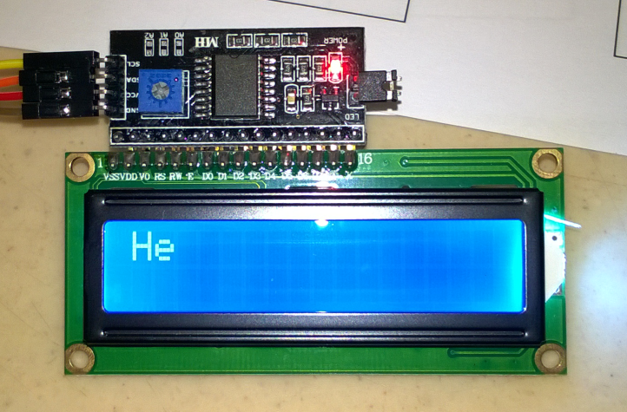
int main( void ){
. . .
auto lcd = hwlib::hd44780( rs, e, d, hwlib::xy( 2, 16 ) );
lcd
<< "\fHello world!"
<< hwlib::flush;
}

Slide 47
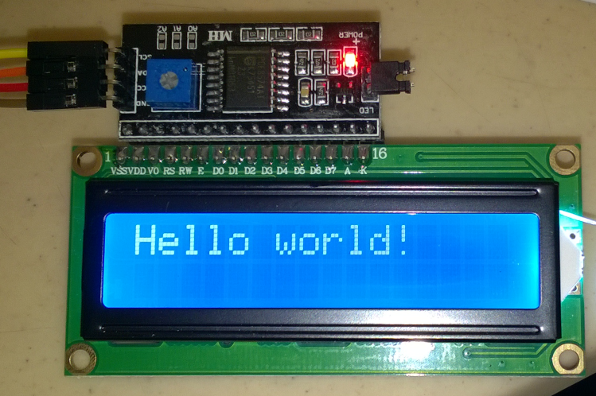
int main( void ){
. . .
auto lcd = hwlib::hd44780( rs, e, d, hwlib::xy( 16, 2 ) );
lcd
<< "\fHello world!"
<< hwlib::flush;
}

Slide 48
Abstract data types
Overloading
Default parameters
Transparent Data Types
Abstract Data Types (private)
int distance = 3246; // in miles
int d; // duration in seconds
d = distance; // oops!

Slide 49
Overloading
Default parameters
Transparent Data Types
Abstract Data Types (private)
#include <iostream>
#pragma GCC diagnostic ignored "-Wparentheses"
#pragma GCC optimize ("rtti")
#include <boost/units/systems/si.hpp>
#include <boost/units/systems/cgs/length.hpp>
#include <boost/units/io.hpp>
const auto meter = 1.0 * boost::units::si::meter;
const auto s = 1.0 * boost::units::si::second;
void print( decltype( meter / s ) v ){
std::cout << "velocity = " << v << "\n";
}
int main(){
auto gravity = 10.0 * meter / ( s * s );
auto duration = 2.0 * s;
print( gravity * duration );
}
documentation?
errors ☹☹☹

Slide 50
OO C++ features
basic OO: interface, with different implementations
decorators / adapters (run-time composition)
for( : )
auto
} (destructors)

Slide 51
OO: a class is just a struct
class xy {
public:
int x, y;
xy( int x, int y ): x( x ), y( y ){}
xy add( xy rhs ){
return xy( x + rhs.x, y + rhs.y );
}
};
auto a = xy( 1, 2 );
auto b = xy( 3, 4 );
auto c = a.add( b );
struct xy {
int x, y;
};
xy add( xy * this_, xy rhs ){
return xy{
this_->x + rhs.x,
this_->y + rhs.y };
}
xy a{ 1, 2 };
xy b{ 3, 4 };
xy c = add( &a, b );

Slide 52
OO: virtuals are just function pointers
struct xy_functions;
struct xy {
int x, y;
const xy_functions *vft;
xy( int x, int y, const xy_functions *vft ):
x( x ), y( y ), vft( vft ){}
};
struct xy_functions {
void (*print)( xy * );
};
void my_xy_print( xy * this_){
std::cout<< "[" << this_->x << "," << this_->y << "]";
};
const xy_functions my_xy_vft = { my_xy_print };
struct my_xy : xy {
my_xy( int x, int y ): xy( x, y, & my_xy_vft ){}
};
void f(){
auto a = my_xy( 42, 84 );
(( xy_functions * ) a.vft )->print( & a );
}
class xy {
public:
int x, y;
xy( int x, int y ): x( x ), y( y ){}
virtual void print() = 0;
};
class my_xy : public xy {
public:
my_xy( int x, int y ): xy( x, y ){}
void print() override {
std::cout << "[" << x << "," << y << "]"; }
};
void f(){
auto a = my_xy( 1, 2 );
a.print();
}

Slide 53
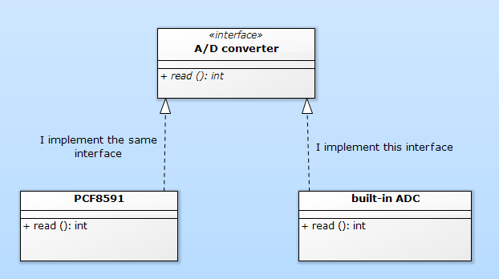
One interface, multiple implementations

Slide 54
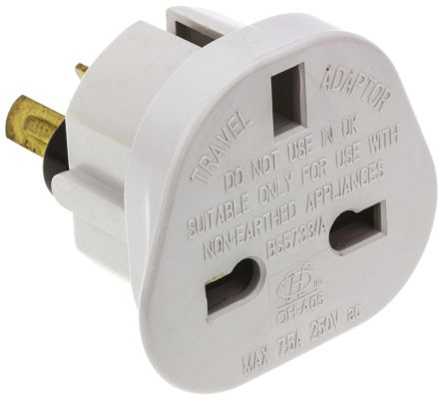
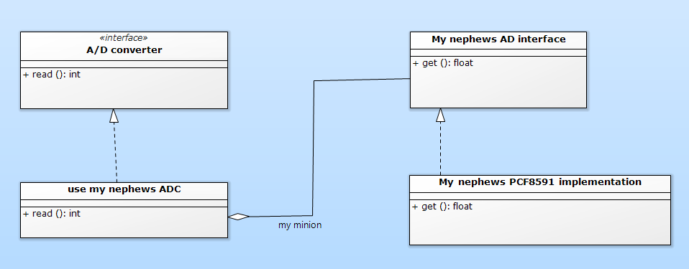
Adapter: one interface on top of another one

Slide 55
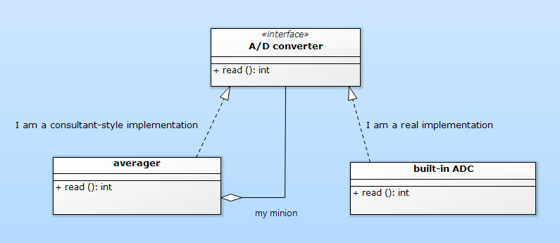

Decorator: modified semantics over the same interface

Slide 56
for

Slide 57
destructors

Slide 58

Modern C++ features
Templated interfaces
Domain Specific Languages
Compile-time composition (CRTP)
Real Magic (Odin, Chiel, …)

Slide 59
Hwlib

Slide 60
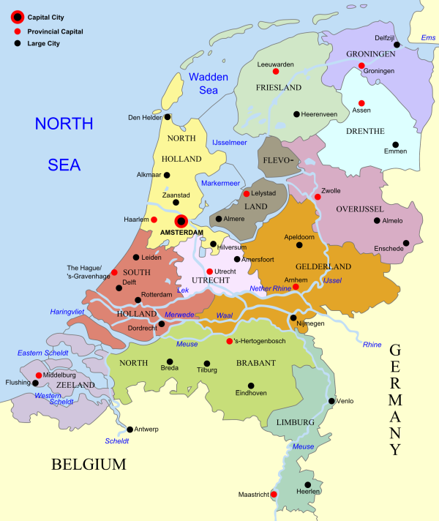
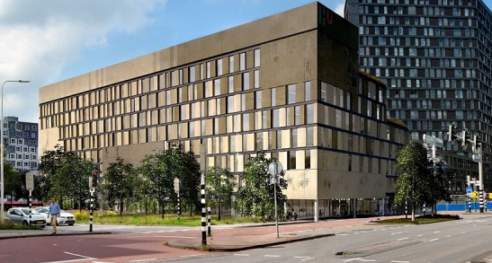
HBO-ICT

Slide 61
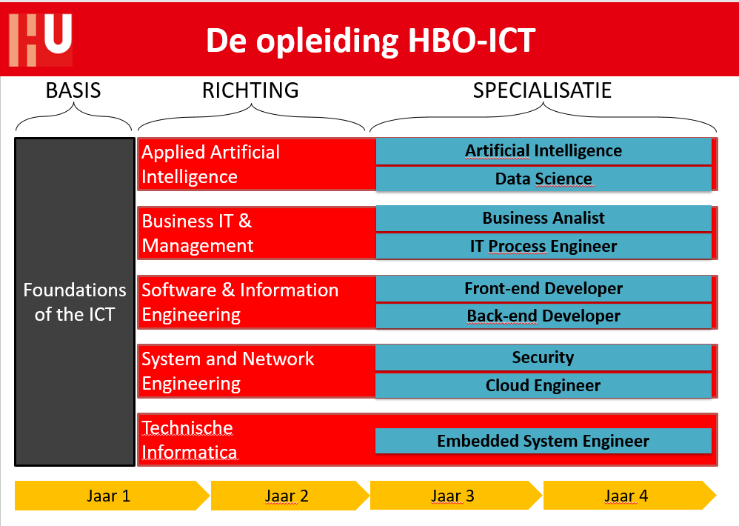

Slide 62
Q1
Programming (Python)
Computer systems & networks
ICT and organization
Q2
Modelling (BPMN, use-cases, databases)
ASK (Critical thinking, logics, statistics)
Group project (collaboration, agile, professional skills)
Q3
procedural programming (algorithmics, C++)
operating systems (Linux, RaPi)
Lego Robotics (Lego + BrickPi, C++)
Q4
OO programming and micro-controllers (classic C++, ArduinoDue)
Digital and analog electronics, computer architecture
1st year final project (individual, ArduinoDue, C++)

Slide 63
Q5
Low-level programming (assembly, C++, threading)
Real-time modelling (UML & synchronization)
Laser-Tag project (RTOS, modelling, waterfall, C++)
Q6
High-level programming (C++, resources, STL, patterns, SFML)
Datastructures & algorithms (lists, trees, hashmaps; Python)
Game project (SFML, PC/Linux/Mac, Agile/scrum, C++)
Q7
MRB (sensors, actuators, control)
Vision (image processing)
Development department: large group, proposals, dependencies
continuous integration, tests, changing requirements, self-organizing,
scrum
Q8
Research
Development department cont. – 15 EC total

Slide 64
A manufacturers perspective:
High-volume developer / manufacturer
Keep ‘m hooked!
dedicated IDE, toolchain, code generator, etc.
Low-volume developer / education / hobby
➔ not very insteresting

Slide 65
A teachers perspective:
I don’t care much which target is used, but it must be
Cheap
Available for a long time
Be a Cortex (-M) (for the assembler lessons)
I want to be able to switch targets easily.

Slide 66
Steps for micro-controller development:
Write the code
Compile
Link on your host system (Windows, Mac, Linux)
Download to the target system
Run on the target system
Observe the effects, goto step 1

Slide 67
Resources for micro-controller development:
Cross-toolchain (compiler & linker)
Language library & runtime (standalone subset…)
Chip headers
Chip startup code
Chip linker script
Download tool
Download hardware
Target system

Slide 68
What I use / provide
Cross-toolchain
Language library & runtime
Chip headers
Chip startup code
Chip linker script
Download tool
Download hardware
Target system
Hwlib
GCC
bmptk
www.github.com/wovo/bmptk
Arduino Due

Slide 69
(other) Interesting targets:
AVR8 (AtMega328P, Arduino Uno/Nano/Micro, has issues)
(MSP430: to prove that 16-bit still exists)
Cortex-M (Arduino Due, Blue Pill, lots of manufacturer boards)
(Tensilica: ESP8266, ESP32)
(MIPS: Microchip, 32-bit DIP micro-controllers)
(Cortex-A: Pi bare-metal)

Slide 70
Hwlib: embedded OO library
Used in classes, so:
Use what the students know (OO syntax, no templates)
Don’t provide what they can make themselves
Solving already solved problems is not a problem
www.github.com/wovo/hwlib

Slide 71
Hwlib
Some available abstractions:
Timing (wait, time-of-day)
GPIO pin, GPIO port (bunch of pins)
ADC, DAC
I2C, SPI
Character I/O
Graphics

Slide 72
Hwlib - some available implementations
HAL for AVR8 (uno) and some Cortex-M (due, blue-pill)
Bit-banged UART, I2C, SPI
PCF8591, PCD8574, HC595
HD44780 (char LCD), SSD1306 (graphic OLED)

Slide 73
Hwlib
Some available ‘layers’:
Pin & port decorators/adapters/creators
Graphics
Character terminal, also on graphics
Multi-threading (separate library)

Slide 74
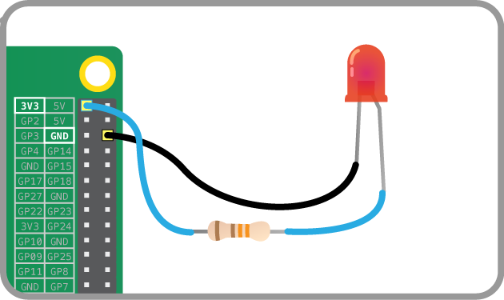
Let’s blink a LED!

Slide 75
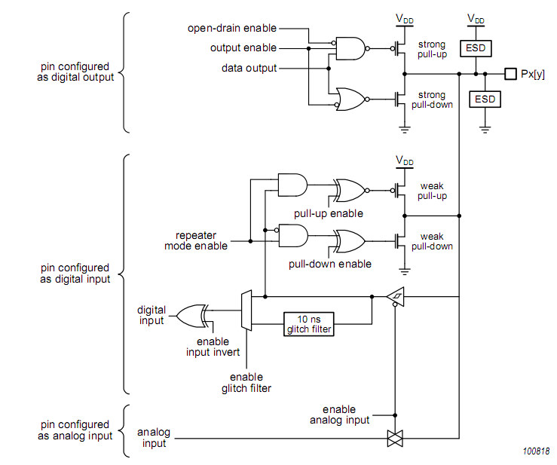
GPIO
Internal circuit

Slide 76
GPIO
Protection

Slide 77
GPIO
Output circuit

Slide 78
GPIO
Input circuit

Slide 79
GPIO
Pull-up / pull-down circuit

Slide 80
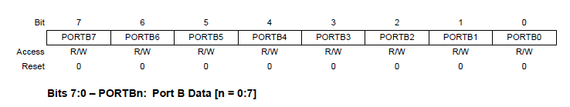
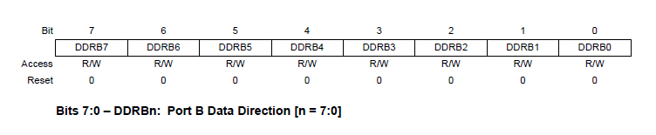
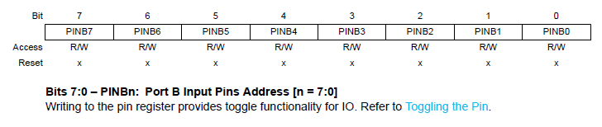
atMega328 (Arduino Uno)

Slide 81
Blink : atMega328 (Arduino Uno)
#include "hwlib.hpp"
int main( void ){
DDRB |= ( 0b01 << 5 );
for(;;){
PORTB &= ~( 0b01 << 5 );
for( volatile uint32_t i = 0; i < 50'000; ++i );
PORTB |= ( 0b01 << 5 );
for( volatile uint32_t i = 0; i < 50'000; ++i );
}
}

Slide 82
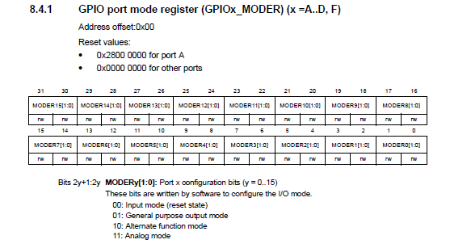
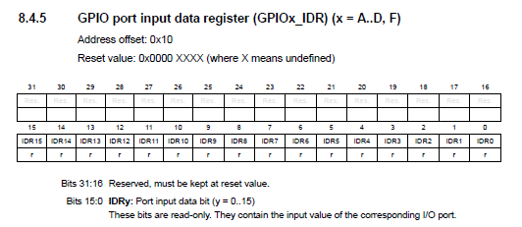
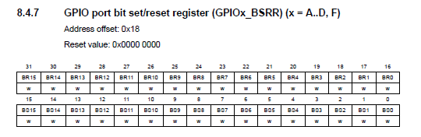
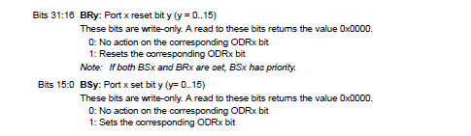
STM32F103 (Blue Pill)

Slide 83
Blink : STM32F103 (Blue Pill)
#include "hwlib.hpp"
int main( void ){
GPIOB->CRH &= ~( 0xF << ( 5 * 4 ));
GPIOB->CRH |= 0x03 << ( 5 * 4 );
for(;;){
GPIOB->BSRR |= ( 0x01 << 13 );
for( volatile uint32_t i = 0; i < 10'000; i++ ){}
GPIOB->BSRR |= ( 0x01 << ( 13 + 16 ));
for( volatile uint32_t i = 0; i < 10'000; i++ ){}
}
}

Slide 84
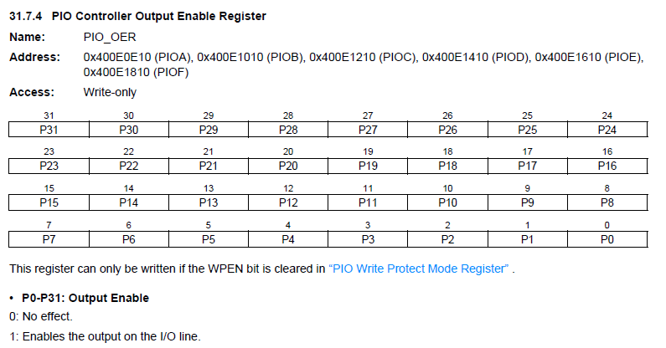



ATSAM3X8E (Arduino Due)

Slide 85
Blink : ATSAM3X8E (Arduino Due)
#include "hwlib.hpp"
int main( void ){
PIOB->PIO_OER = { 0x1U << 27 };
for(;;){
PIOB->PIO_SODR = 0x01 << 27;
for( volatile uint32_t i = 0; i < 100'000; i++ ){}
PIOB->PIO_CODR = 0x01 << 27;
for( volatile uint32_t i = 0; i < 100'000; i++ ){}
}
}

Slide 86
Blink - abstraction
int main( void ){
auto led = hwlib::target::pin_in_out( 1, 5 );
led.direction_set_output();
for(;;){
led.write( 1 ); led.flush();
hwlib::wait_ms( 100 );
led.write( 0 ); led.flush();
hwlib::wait_ms( 100 );
}
}

Slide 87
Blink – more abstraction
int main( void ){
auto led = hwlib::target::pin_in_out( 1, 5 );
led.direction_set_output();
for(;;){
led.write( 1 ); led.flush();
hwlib::wait_ms( 100 );
led.write( 0 ); led.flush();
hwlib::wait_ms( 100 );
}
}
int main( void ){
auto pin = hwlib::target::pin_out( 1, 5 );
auto led = hwlib::direct( pin );
for(;;){
led.write( 1 );
hwlib::wait_ms( 100 );
led.write( 0 );
hwlib::wait_ms( 100 );
}
}

Slide 88
GPIO pin: types / modes of use
Input
Output
Input-Output
Open-Collector
Pull-up, pull-down

Slide 89
GPIO pins: HAL-provided
auto pin = hwlib::target::pin_in_out( 1, 5 );
auto pin = hwlib::target::pin_in( 1, 5 );
auto pin = hwlib::target::pin_out( 1, 5 );
auto pin = hwlib::target::pin_oc( 1, 5 );

Slide 90
GPIO pin: adapters/decorators
auto pin = hwlib::target::pin_in_out( 1, 5 );
auto p = hwlib::pin_in_from( pin );
auto p = hwlib::pin_out_from( pin );
auto p = hwlib::pin_oc_from( pin );
auto d = hwlib::direct( p );
auto i = hwlib::invert( d );

Slide 91
Ports: bundle of pins
auto p19 = hwlib::target::pin_out( 1, 9 );
. . .
auto scl = hwlib::target::pin_out{ 0, 4 };
auto leds = hwlib::port_out_from_pins(
p19, p18, p15, p14,
p13, p12, p11, p10,
p07, p06, sda, scl
);

Slide 92
Ports: adapters/decorators
auto port = hwlib::port_in_out_from_pins( . . . );
auto p = hwlib::port_in_from( pin );
auto p = hwlib::port_out_from( pin );
auto d = hwlib::direct( p );
auto i = hwlib::invert( d );
auto a = hwlib::all( p );

Slide 93
Three demo functions
blink( pin );
kitt( port );
snake( port );

Slide 94


Slide 95
Some experiences
Getting abstractions right is difficult
➔ we need more communication
Working with classes (instead of objects) is much easier
Documentation tools (Doxygen etc.) are not up to it

Slide 96


Slide 97
Takeaways
If you switch to C++, don’t feel obliged to
go cold turkey (small steps are perfectly OK)
use the whole language (you didn’t use full C either!)
Even old-school OO can be usefull for smal-embedded.

